Slide 1

Assignment - 1
Story Telling
BBA 1st SEM (2022-23)
Submitted By-
Shankh Bansal
AU22C1013
Submitted To-
Dr. Gaurav Bagra

Slide 2
Objectives
Encourage use of imagination and creativity.
Increase verbal proficiency.
To improve communication skills.
Enhance corporation between students.

Slide 3
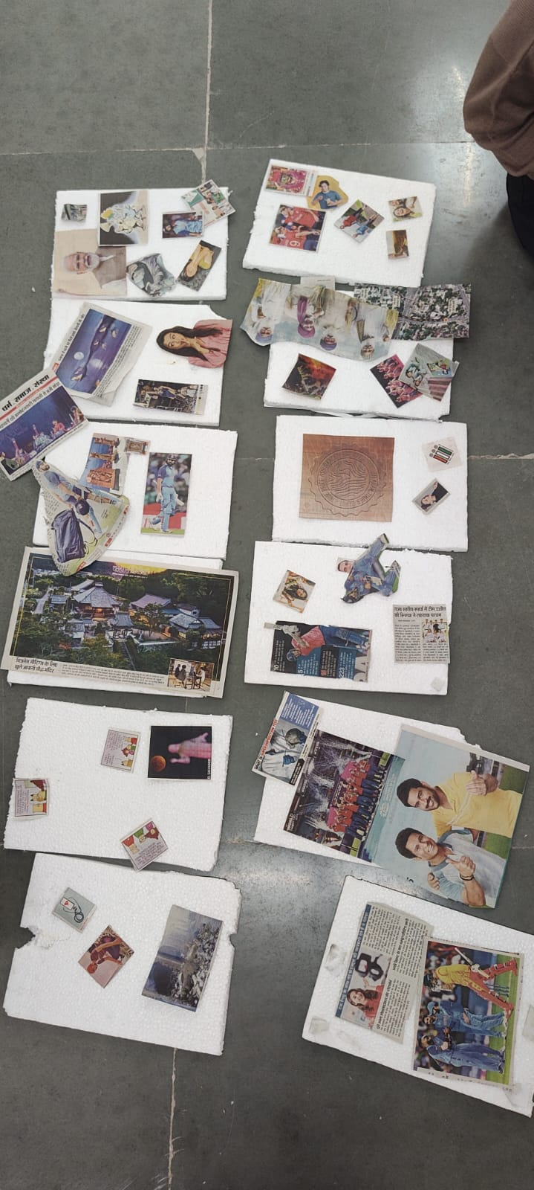
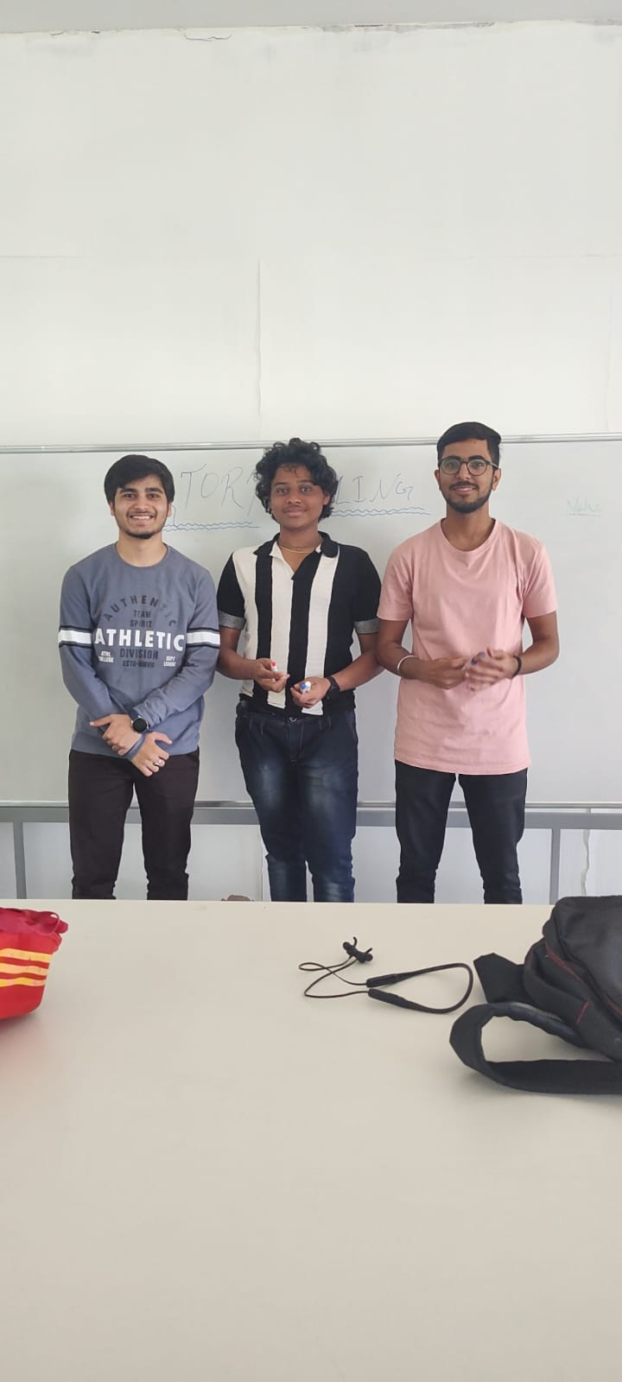
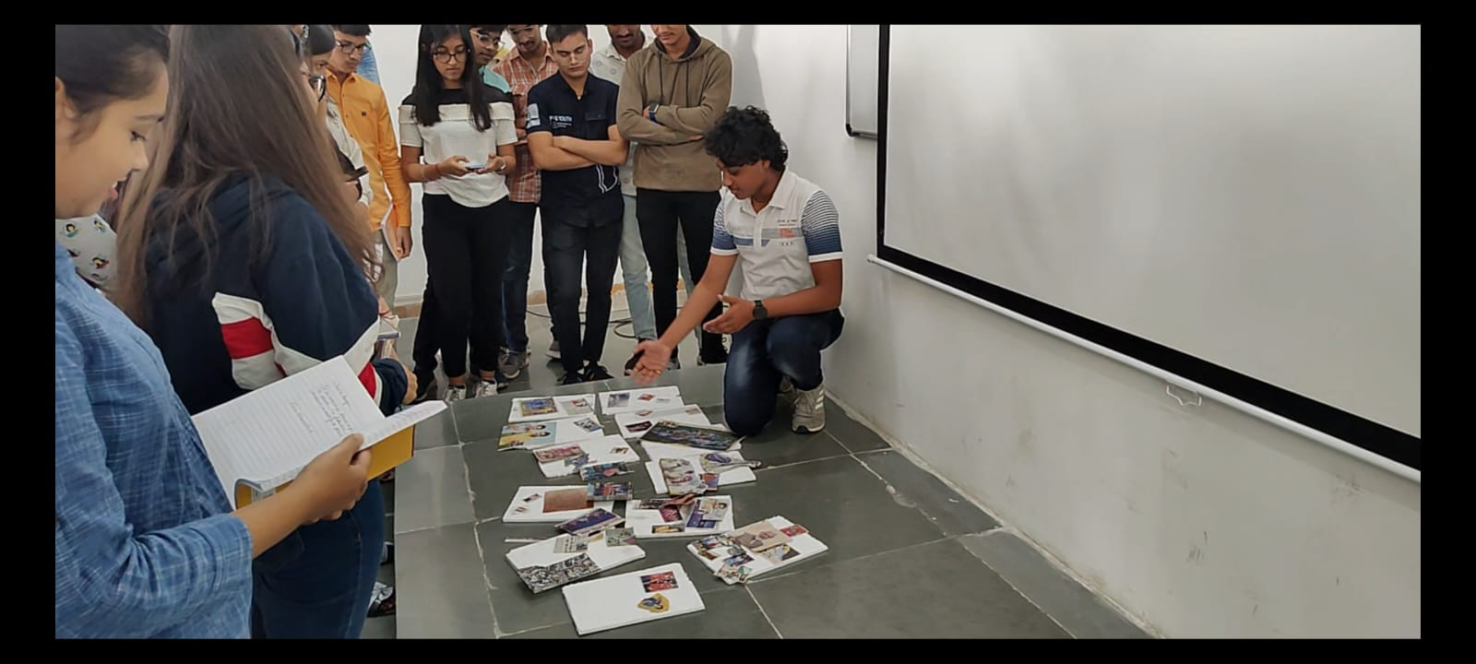
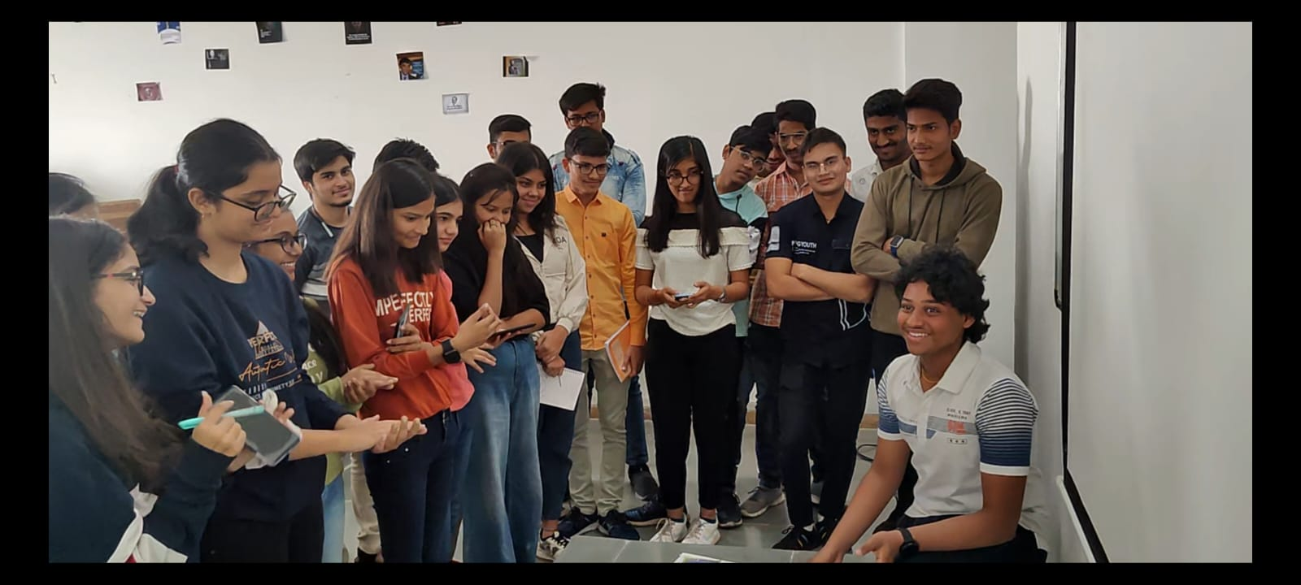
GLIMPESS

Slide 4

Solo Story
In ancient time, a ruler in India poles to pick his successor by playing a game. He asked his participants to grow a plant and the most pretty plant will win. Satin has worked very hard to fulfill the needs of the ruler but he failed to do so he presented the plot without the plant. By seeing the dedication and honesty the ruler decides to give him a reward.

Slide 5
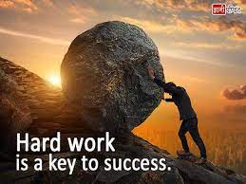
Group Story
A long time ago there lived a boy named Rohit in a village. he was very happy with his family, but his happiness could not last for long. They have faced a severe draught. They all started wishing for rain but there was no rain there crops, tree, cattle were dying and then the stream was drying up very rapidly.
Ones in the village meting Rohit said that there is water under the surface so why don’t we start digging. All agreed upon this decision but after digging for few days they all gives up there hope but Rohit continued to dig. One day during digging Rohit saw water. His attitude of not giving up saved the whole village.

Slide 6

Situation Based Story
Ones there was a girl named Navya who use to bully all the boys in the class, ate there lunch, and made then do his homework. So the class one decided to fight back from the injustice by standing together and restricting him from doing such activity. When time came those boys stood together as a team showing Navya that they are not scared of him anymore. Navya tried to push then harder, in the process he gat beaten up by the class. Thereafter Navya never bullied anyone again as she was shown his place.

Slide 7
Learning Outcomes
Promote a feeling of well-being and relaxation.
Encourage active participation.
Increase verbal proficiency.
Help develop your brain, ability to focus, concentration, social skills and communication skills.

